Slide 1
The Pros and Cons of Airfoil Optimization
Publication by: Mark Drela, MIT AeroAstro Chapter in Frontiers of Computational Fluid Dynamics, 1998 D.A. Caughey, M.M. Hafez, Eds., World Scientific.
Presented by: Peter Sharpe, MIT AeroAstro
Friday, September 30, 2022

Slide 2
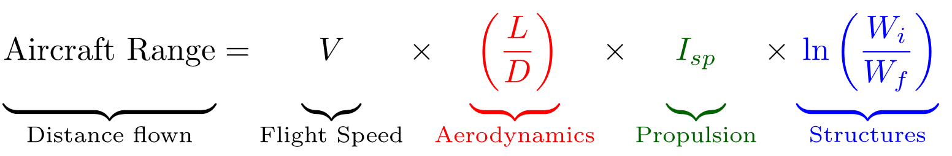
Importance of Aerodynamics
Aircraft performance depends strongly on aerodynamic design.
A first-order effect
Small aerodynamic improvements directly yield:
Better range
Lower cost
Lower emissions

Slide 3
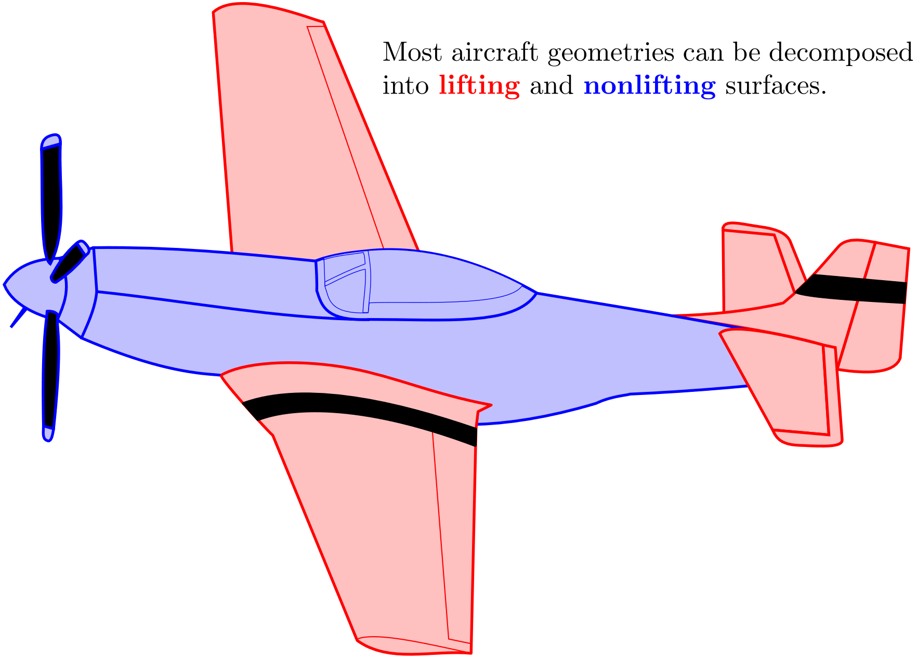
Typical Aerodynamics Approaches
Aerodynamics analysis of general 3D shapes is computationally expensive
Too slow to analyze many new designs
To simplify, we often split the geometry into easier-to-analyze parts:
Lifting surfaces
Nonlifting surfaces
Lifting surfaces dominate aerodynamic forces, so we focus on those

Slide 4
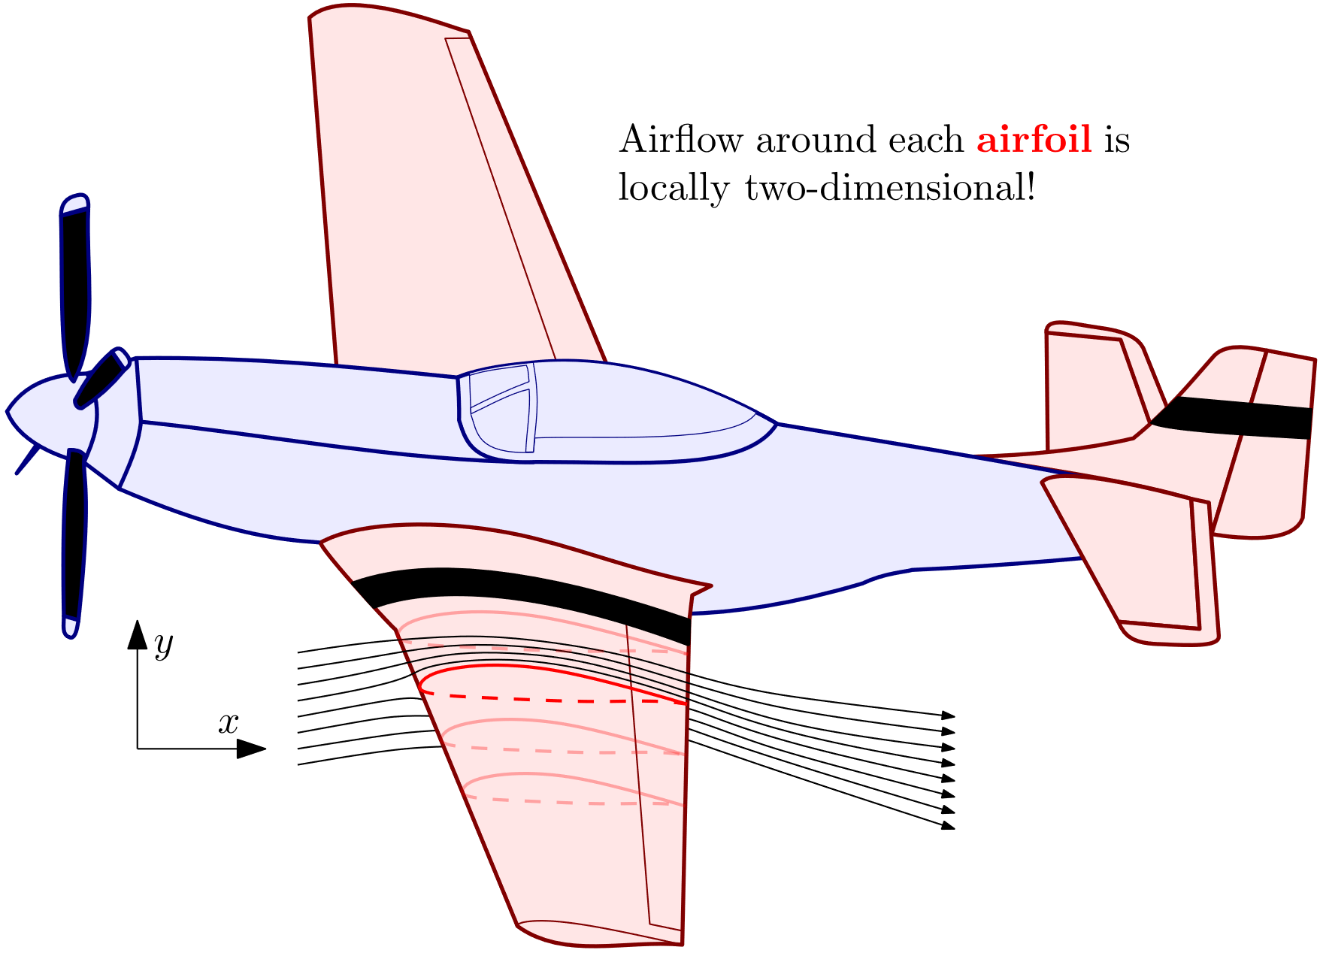
Airfoil: a 2D Slice of a Wing
Key insight:
Airflow around a typical wing is almost 2-dimensional.
A typical fast aerodynamics analysis method:
Treat wing as a stack of 2D slices: “airfoils”.
Analyze each as 2D and integrate profile drag across wing
Capture 3D effects afterwards with (fast) inviscid analysis

Slide 5
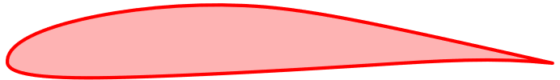
If we can design better airfoils, we can design better wings and airplanes.

Slide 6
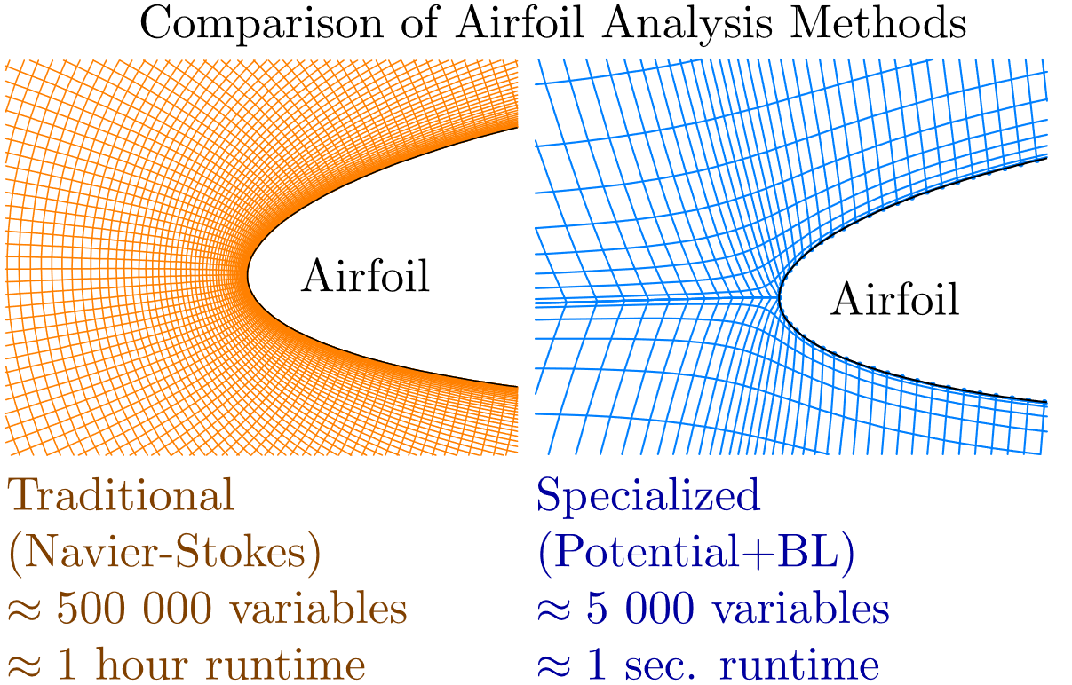

Advances in Airfoil Analysis Tools
Prior work by Drela enables:
Extremely Fast Analysis
1000x faster airfoil aerodynamics analysis compared to traditional methods (with same accuracy)
Gradient Information
Traditional aerodynamics analysis:
Modern aerodynamics analysis:
Tells you not only how your design did, but also how to improve it!
Negligible extra computational cost
Suitable for gradient-based optimization
Airfoil Shape
Analysis
Lift
Drag
Lift
Drag
$\frac{∂(\text{Lift}\text{, }\text{Drag})}{∂(\text{airfoil} \text{shape})}$
Airfoil Shape
Analysis
Figure adapted from M. Drela, Fast 3D Viscous Calculation Methods, MIT report, 2013.

Slide 7
A natural question: Can we design better airfoils by using these new analysis tools for computational optimization?

Slide 8
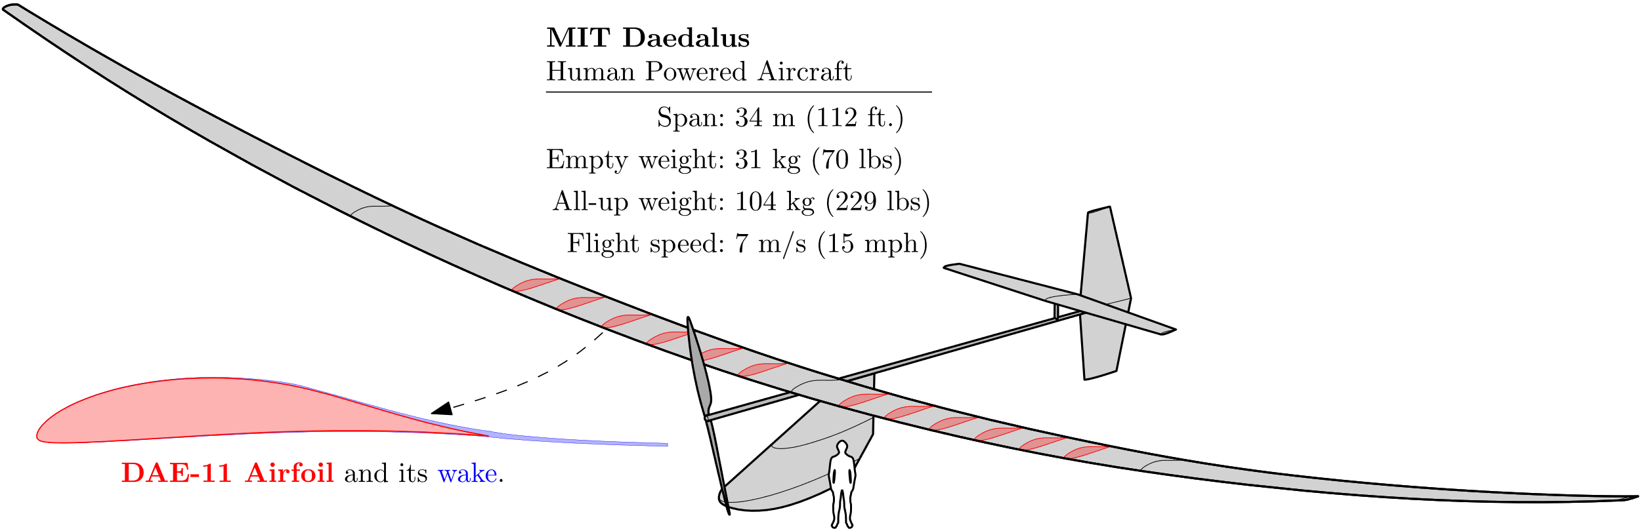

Case Study: Airfoil Design for MIT Daedalus
World-record human-powered aircraft (1988)
Lightweight $→$ Slow flight speed $→$ unique and delicate viscous aerodynamics
Designing airfoils that account for these effects is not intuitive
Can optimization help?
Notes:
About the same wingspan as a Boeing 737
But weighs about as much as a large dog

Slide 9
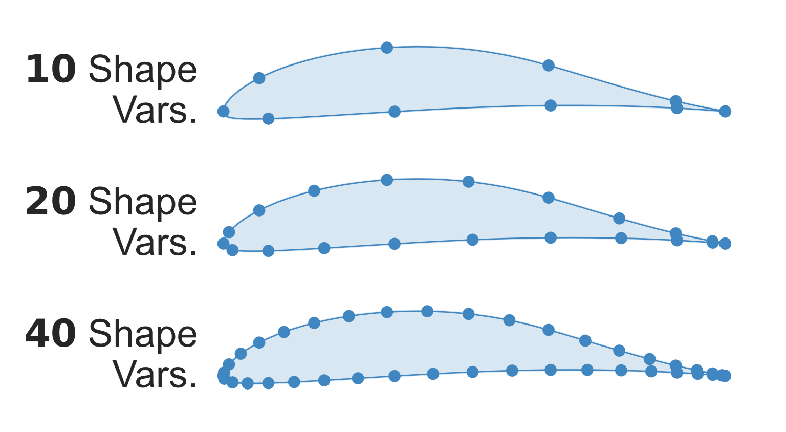


Daedalus Airfoil Design in an Optimization Lens
Need to quantify our abstract design goals into an optimization problem:
Objective Function
The metric you aim to minimize
Minimize Drag ($C_{d}$)
Variables
The values you can change
Airfoil Shape
(10, 20, or 40 shape variables)
Constraints
Equalities and inequalities that limit your design choices
Wing should make enough lift $$C_{l}=1.25$$
Wing shouldn’t twist itself apart $$C_{m}=−0.133$$
Wing should be manufacturable
$θ_{TE}=6.25°$, $θ_{LE}=180°$
${\left(\frac{t}{c}\right)}_{0.33c}=0.128$, ${\left(\frac{t}{c}\right)}_{0.90c}=0.014$

Slide 10
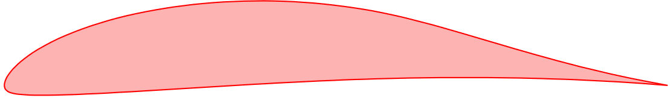
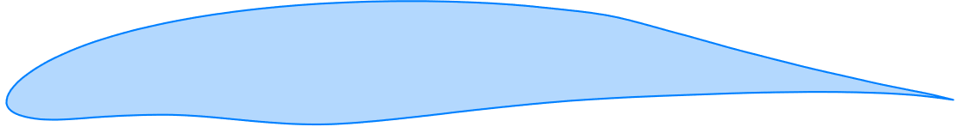


Daedalus Airfoil Optimization Results
Optimization achieves substantial drag reduction:
Before Optimization (DAE-11)
All constraints satisfied
Manually designed by expert
$$\text{Drag} C_{d}=0.0994$$
After Optimization
All constraints satisfied
Designed by computer optimization
$$\text{Drag} C_{d}=0.0836$$
$−16\%$drag reduction!

Slide 11
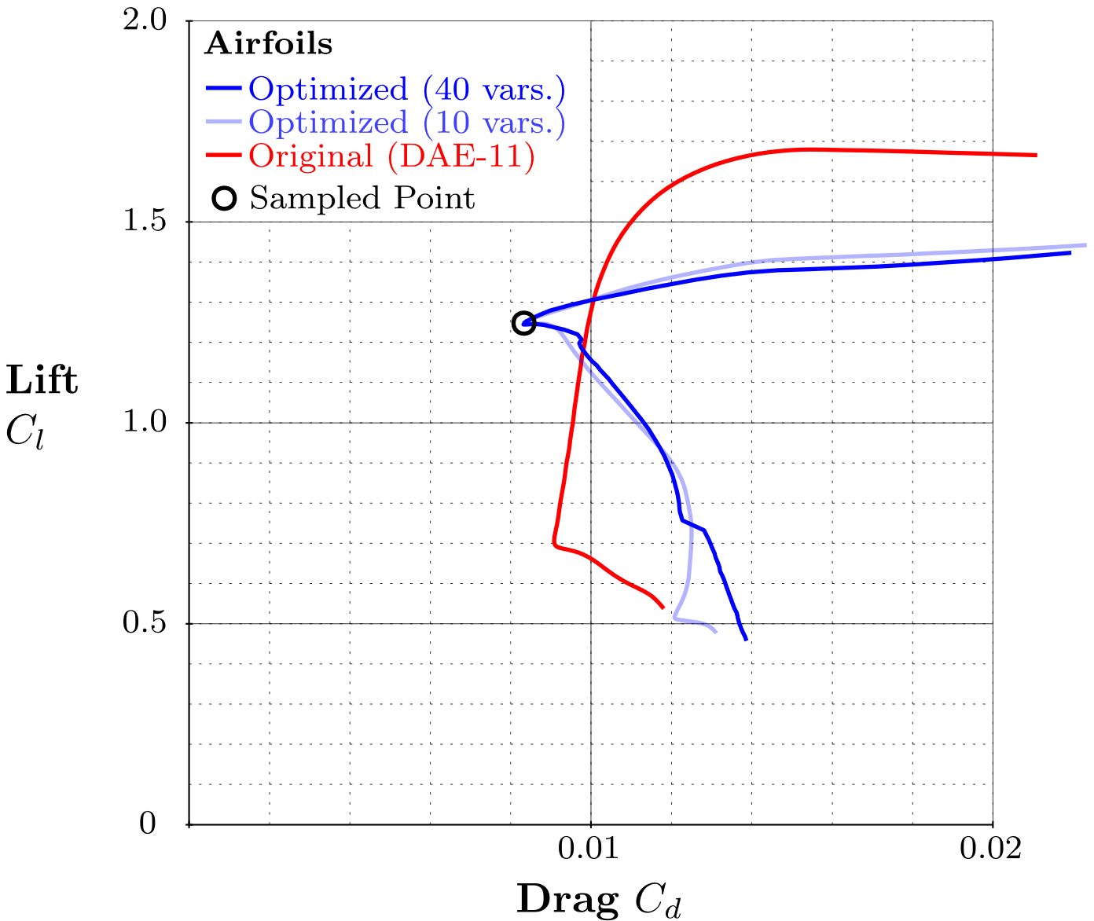
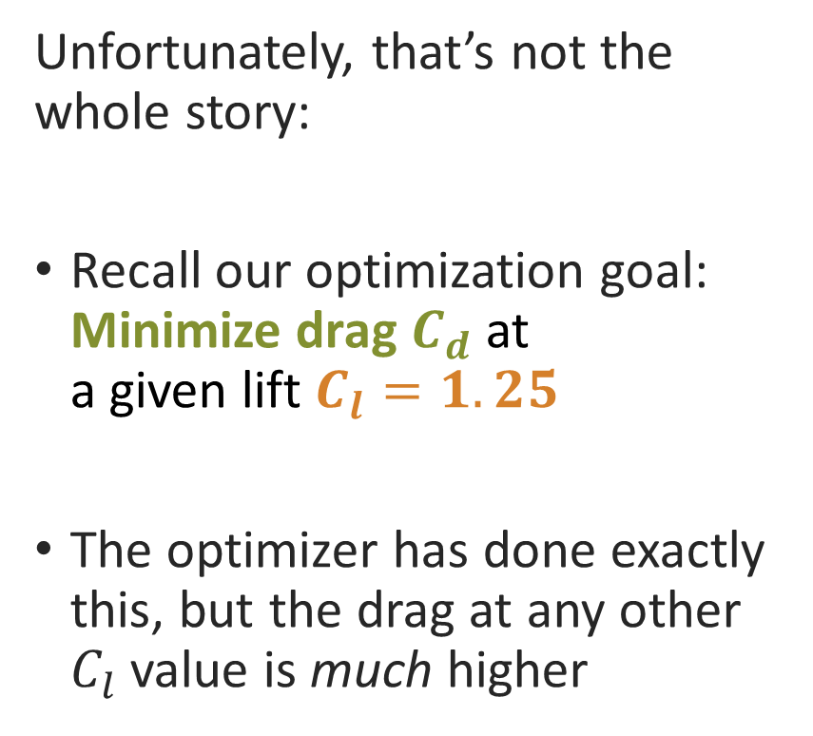
An Optimization Pitfall
Unfortunately, that’s not the whole story:
Recall our optimization goal: Minimize drag $C_{d}$ at a given lift $C_{l}=1.25$
The optimizer has done exactly this, but the drag at any other $C_{l}$ value is much higher

Slide 12
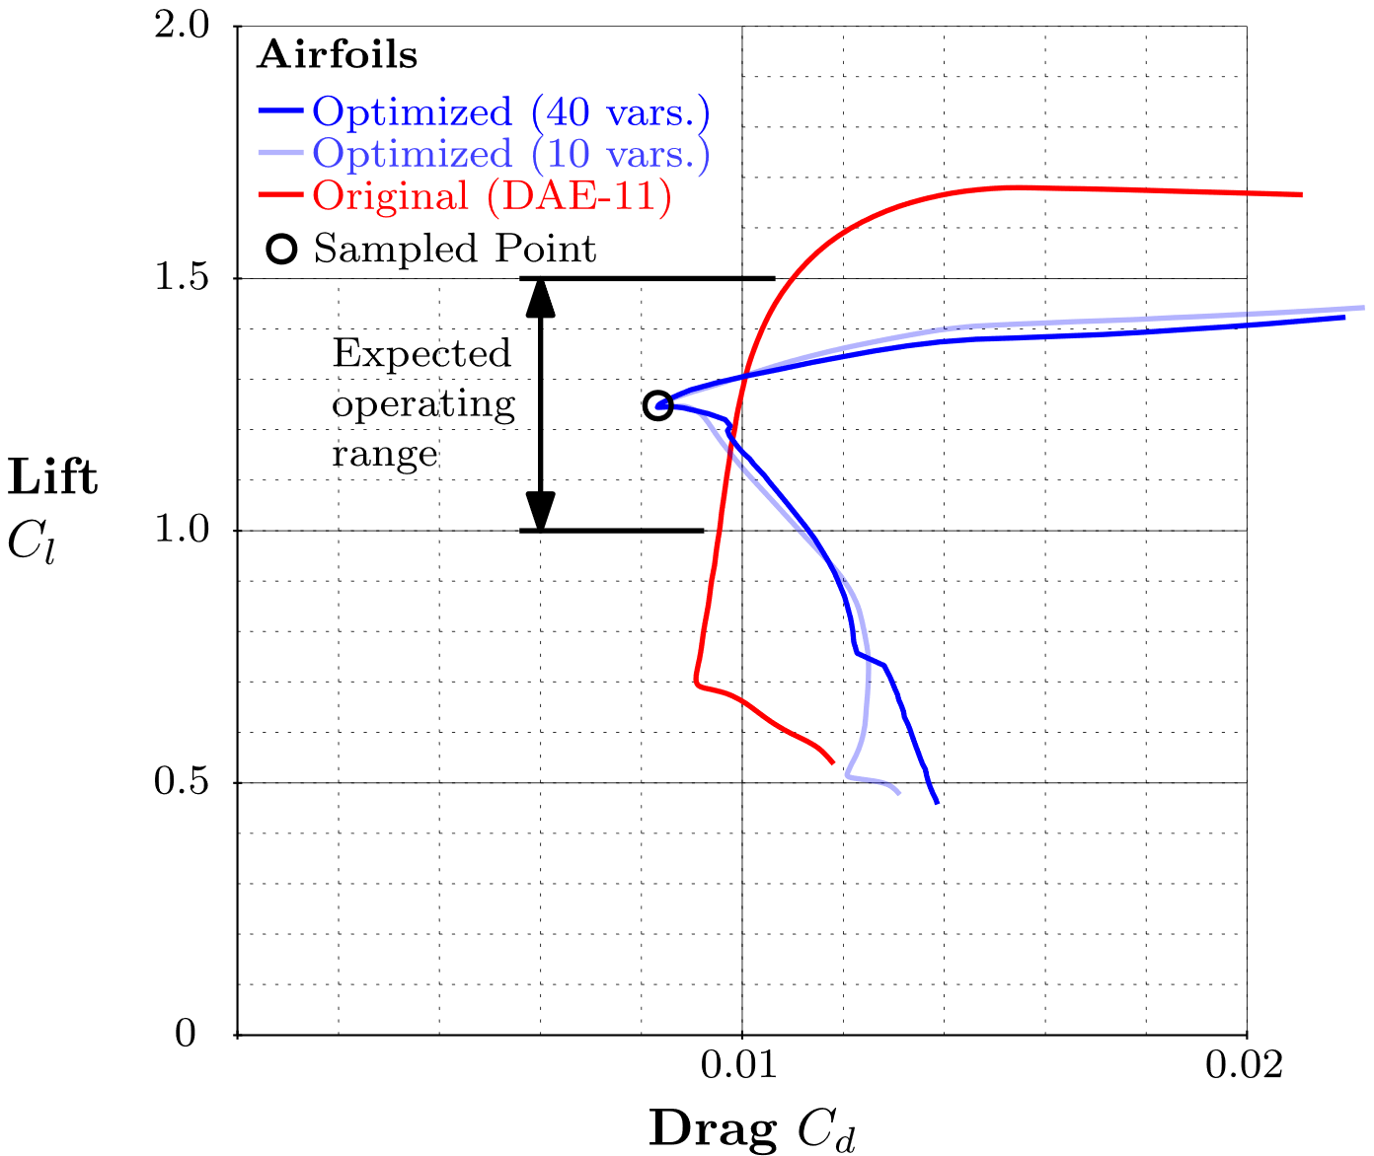
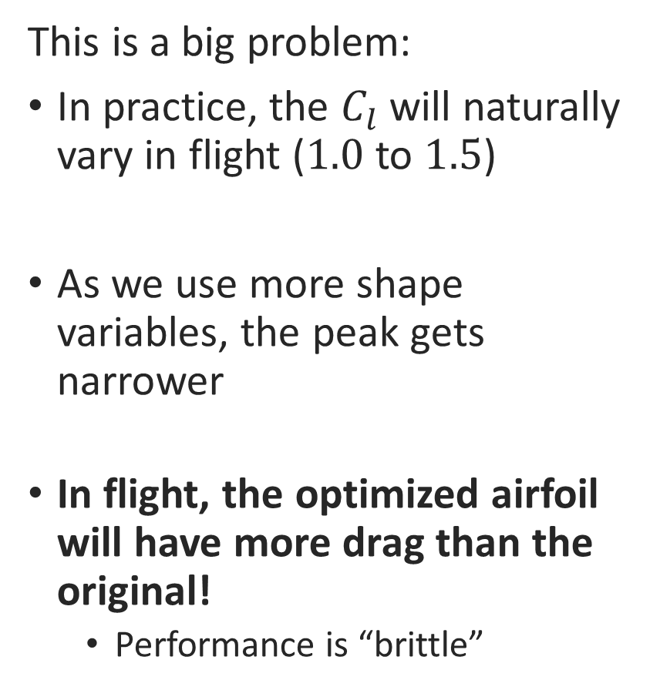
An Optimization Pitfall
This is a big problem:
In practice, the $C_{l}$ will naturally vary in flight ($1.0$ to $1.5$)
As we use more shape variables, the peak gets narrower
In flight, the optimized airfoil will have more drag than the original!
Performance is “brittle”

Slide 13
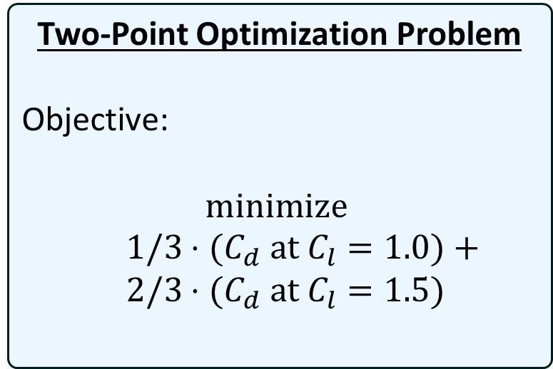
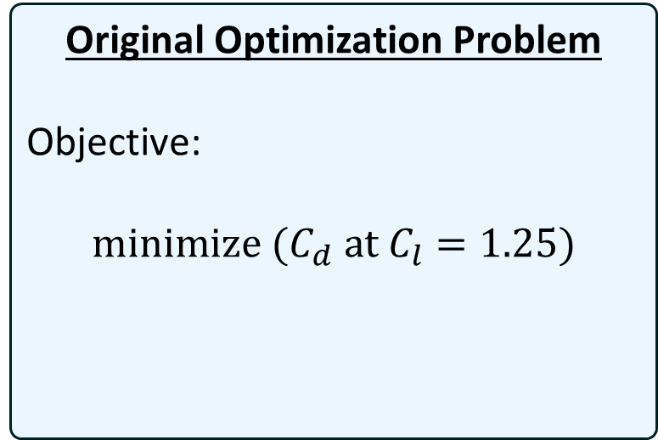
Two-Point Optimization
What went wrong?
Optimizer gave us the right answer, but to the wrong problem
What might be a better problem to ask?
Original Optimization Problem
Objective:
$$\text{minimize} {(C}_{d} \text{at} C_{l}=1.25)$$
Two-Point Optimization Problem
Objective:
$$\text{minimize}$$
$1/3⋅{(C}_{d} \text{at} C_{l}=1.0)+$
$2/3⋅{(C}_{d} \text{at} C_{l}=1.5)$

Slide 14
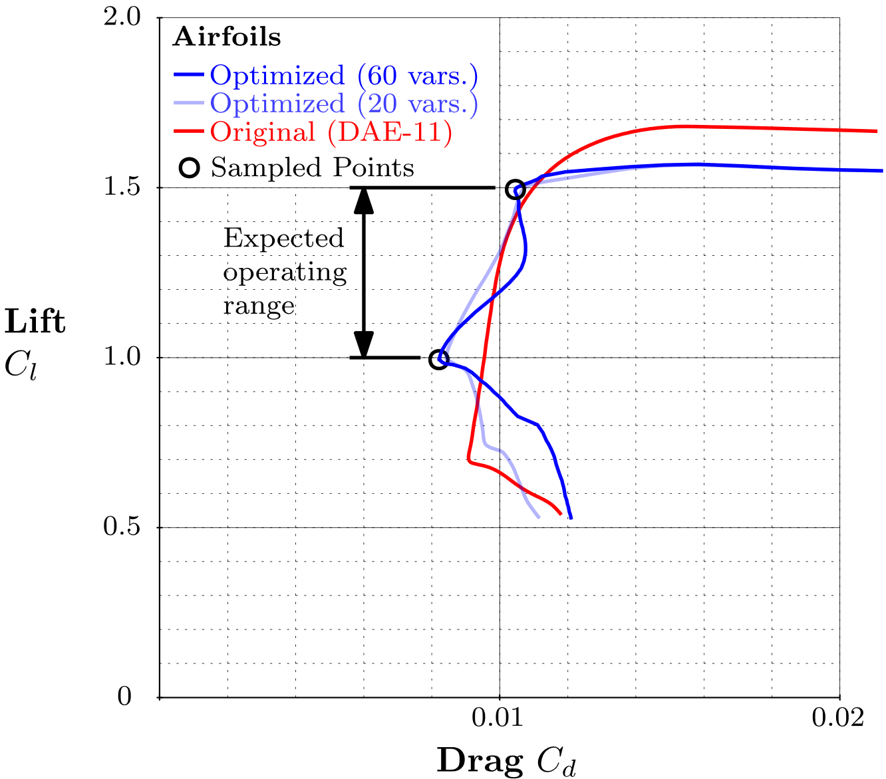
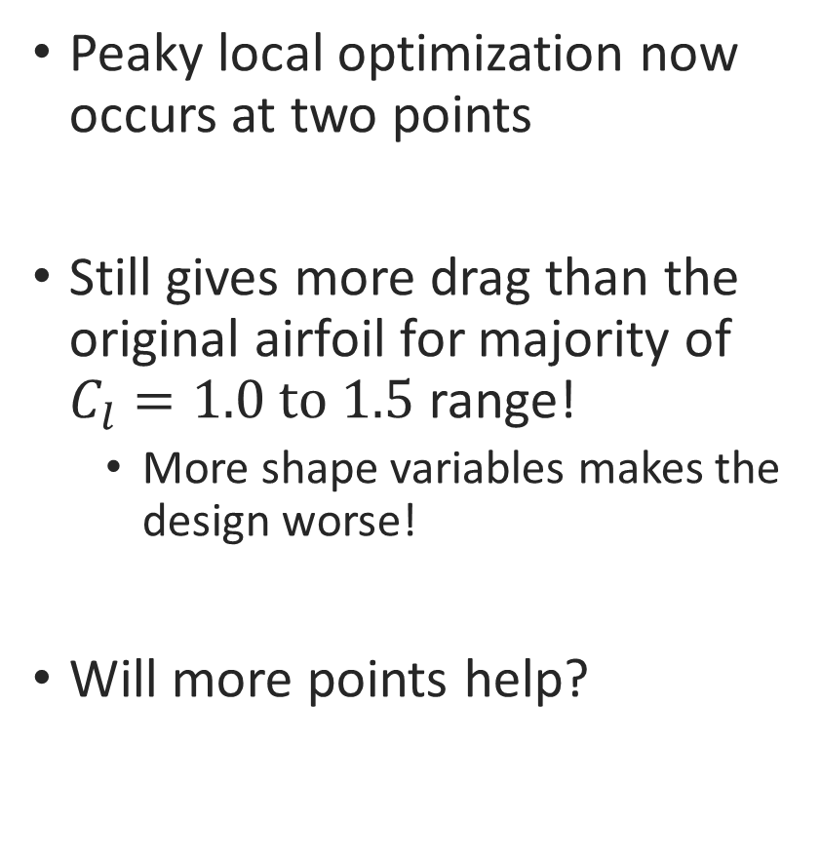
Two-Point Optimization
Peaky local optimization now occurs at two points
Still gives more drag than the original airfoil for majority of $C_{l}=1.0 \text{to} 1.5$ range!
More shape variables makes the design worse!
Will more points help?

Slide 15
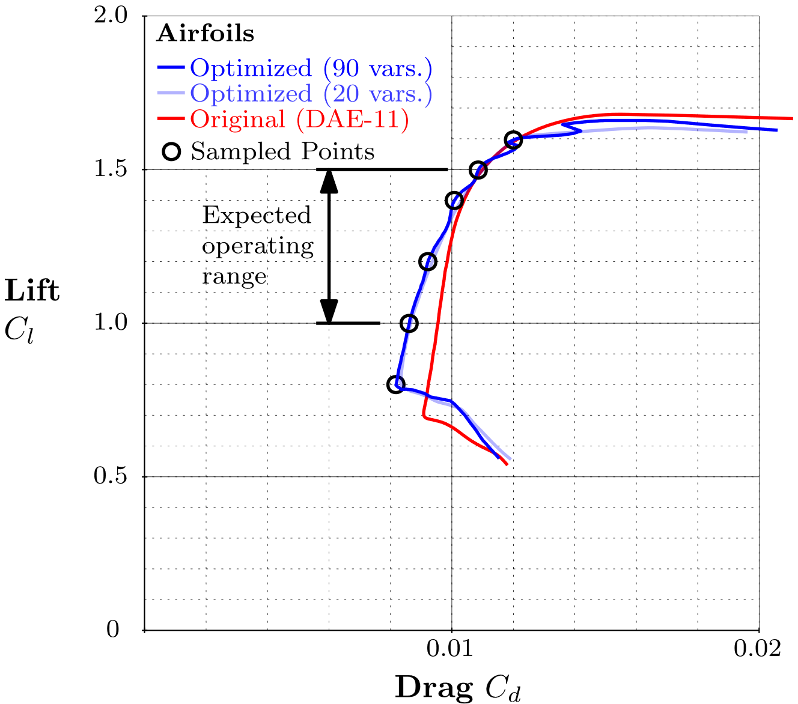
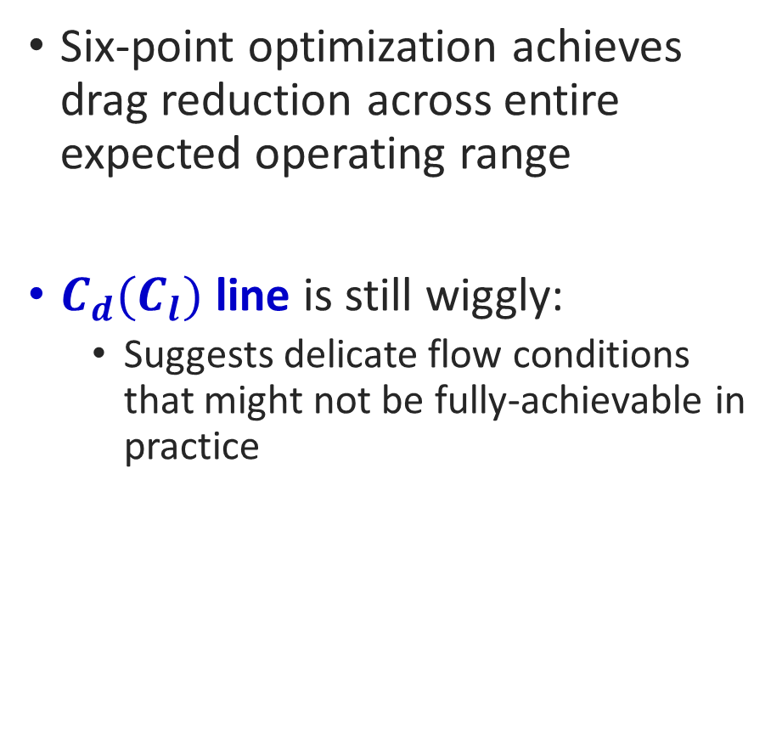
Six-Point Optimization
Six-point optimization achieves drag reduction across entire expected operating range
$C_{d}(C_{l})$ line is still wiggly:
Suggests delicate flow conditions that might not be fully-achievable in practice

Slide 16
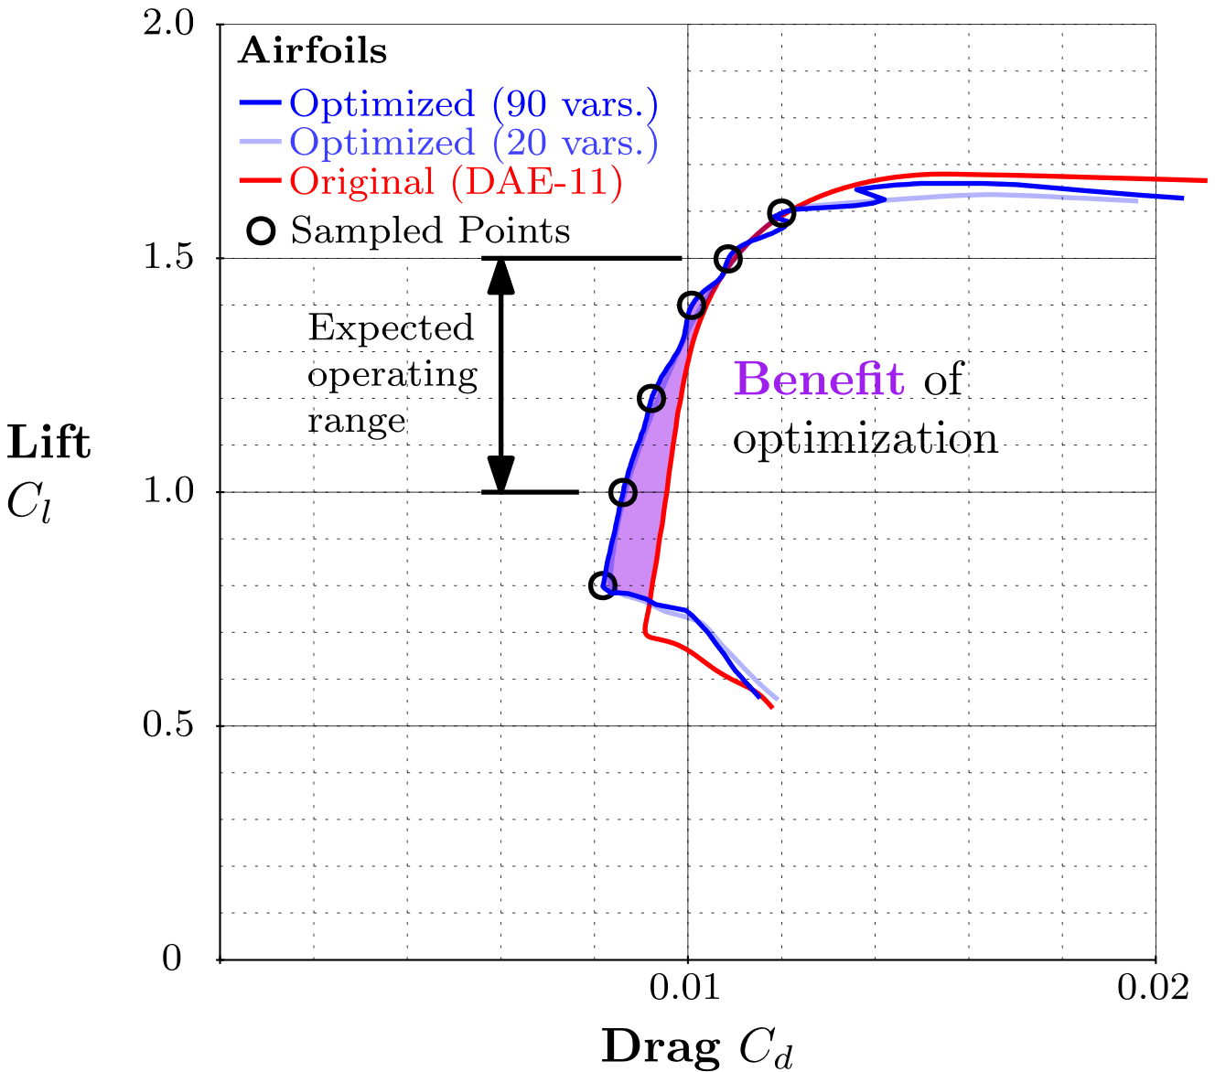
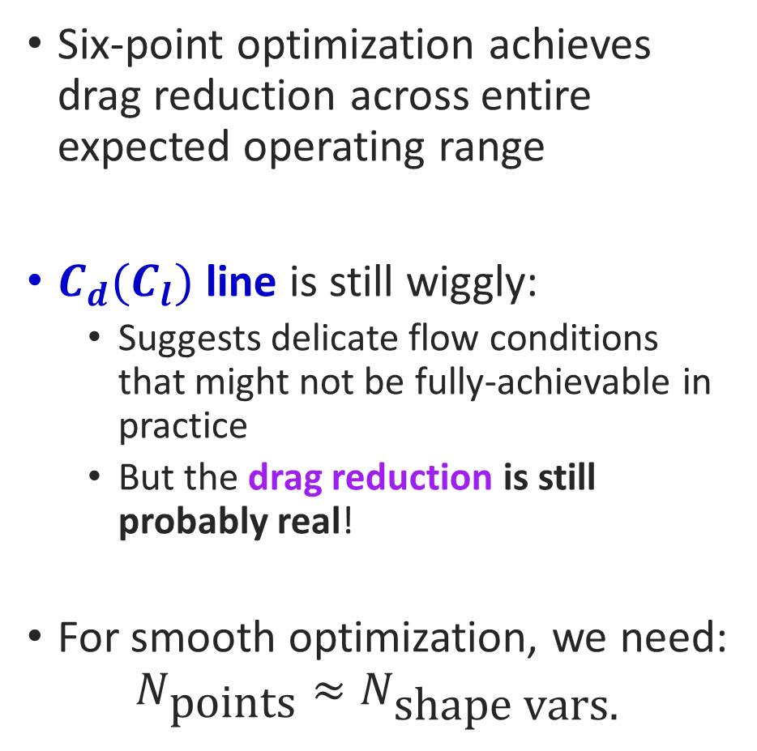
Six-Point Optimization
Six-point optimization achieves drag reduction across entire expected operating range
$C_{d}(C_{l})$ line is still wiggly:
Suggests delicate flow conditions that might not be fully-achievable in practice
But the drag reduction is still probably real!
For smooth optimization, we need:
$$N_{\text{points}}≈N_{\text{shape} \text{vars}\text{.}}$$

Slide 17
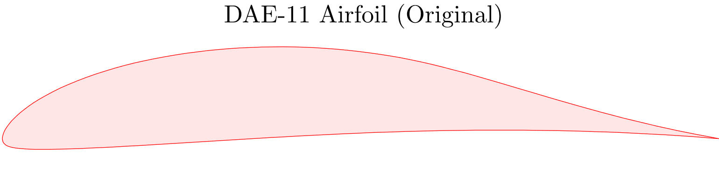
Still Missing Constraints
Can we actually build and fly any of these airfoils?

Slide 18
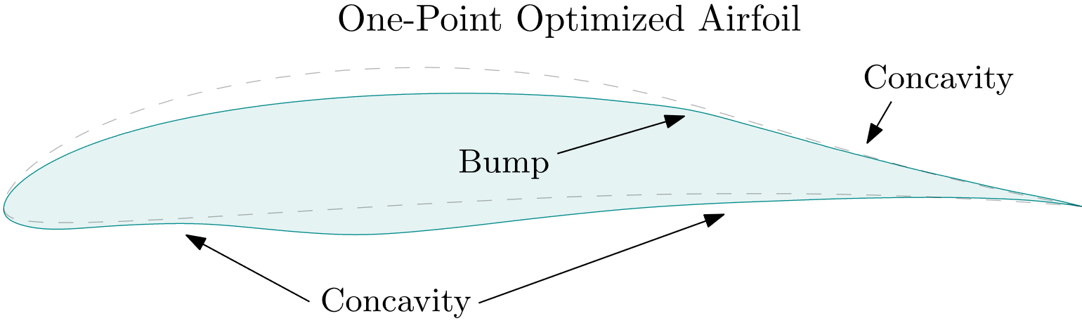
Still Missing Constraints
Can we actually build and fly any of these airfoils?

Slide 19
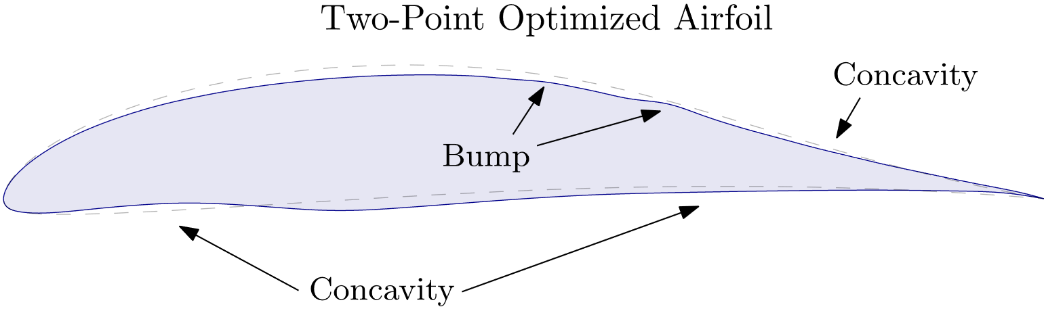
Still Missing Constraints
Can we actually build and fly any of these airfoils?

Slide 20
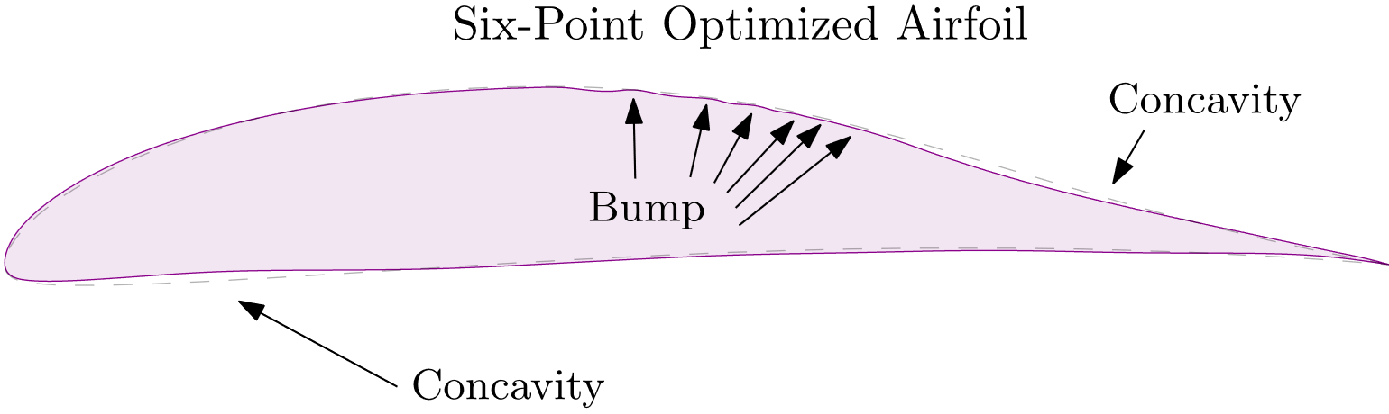
Still Missing Constraints
Can we actually build and fly any of these airfoils?

Slide 21
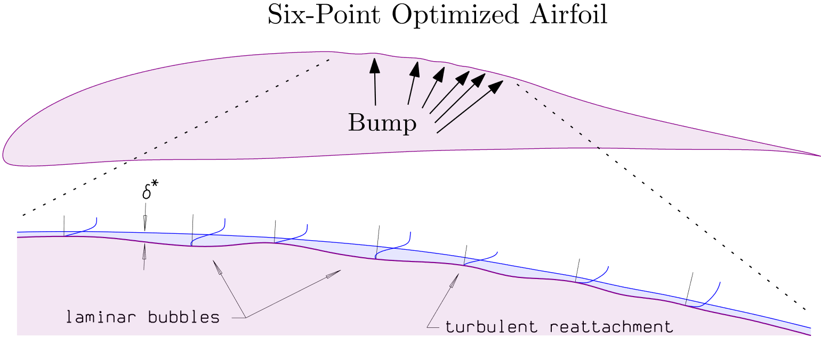
Boundary Layer Physics
Optimizer is manipulating tiny geometric features

Slide 22
Pros and Cons of Airfoil Optimization
Pros
Cons
Tells you possible directions of improvement when intuition is exhausted
Usable for design problems with unusual drivers, if these can be precisely quantified
Will give you the right answer, if you can pose the right problem
Even for experts, it’s very difficult to pose the right problem on the first try.
Instead of iterating on the design, you must iterate on the problem
Undesirable local optimization
The “almost-devious cleverness of an optimizer armed with many shape variables”
Manipulates geometry at tiny scales that may not be manufacturable

Slide 23
Optimization can be extremely powerful, but it’s not a magic button – needs supervision

Slide 24
Questions?

